Slide 1
Pre-historic Inhabitants of the Islands
…or, Meanwhile, in the Atlantic…

Slide 2
In the previous slide presentation, we were up to the birth of Christ, when the Roman Empire was at the height of its power. Now, as we go from the continent to the islands, we have to back up.
We probably know more about the pre-historic inhabitants of what is now Scotland than we do the inhabitants of any of the rest of the area. They are called Picts, from a Latin word meaning “the painted ones,” since the first ever mention of them is in 297 A.D. (when Latin was the predominant language). Presumably, they tattooed themselves, but the truth is that we know very little about them. We have stones with symbols from their language, but that language has been lost, so we don’t know how to interpret the symbols.
You may read that Picts were the early Celts of Scotland, but don’t believe everything you read. There’s nothing in the symbols to indicate that they spoke a Celtic language, and as we’re going to see later, “Celtic” is a somewhat complicated concept. The Celts were not the original inhabitants of any of the islands.
If you google “origins of the British,” you will find two main topics: Celts and DNA. There are new theories on who the original Britons were because of the growing DNA studies, but we’ll get into that a bit later.
J.P. Mallory wrote a very informative book entitled The Origins of the Irish. He discusses the archeological evidence, and he presents some interesting discoveries about the inhabitants of pre-historic Ireland. But as for who they were & where they came from? The jury is still out.
When we study early civilizations, like the Celts & Etruscans & Phoenicians, it seems to be easier to trace their paths forward than it is to go backwards from a location & figure out who the original people were. In other words, it’s easier to look at the Celts in 600 B.C. and follow them into their future than it is to look at the first couple of hundred years A.D. in Ireland & work backwards to find out where those A.D. inhabitants came from. And the fact that we can trace the Celts from 600 B.C. to the time of Christ & have virtually no evidence of their having crossed to the islands messes with the traditional view of Celts as the earliest inhabitants of the islands.

Slide 3
Take a moment & ask yourself why, until fairly recently, it was believed that Celts were the original (or at least pre-Roman) inhabitants of the islands.
Short answer: the language. Gaelic and Gallic (from Gaul), as well as other extinct languages from the Celtic regions on the continent, are Celtic languages, unquestionably descended from the same mother language. So at one point, that language, known as proto-Celtic, was spoken by a single group of people, and as they spread, so did it, changing into different dialects & languages, just as Latin did.
We’ll discuss language more in depth later, because, obviously, Celtic got to Ireland, Scotland, Wales, Cornwall (in England), Brittany (in France), and the Isle of Man some way. And language is a very important consideration when we ask the question, “Who are the Celts?”

Slide 4
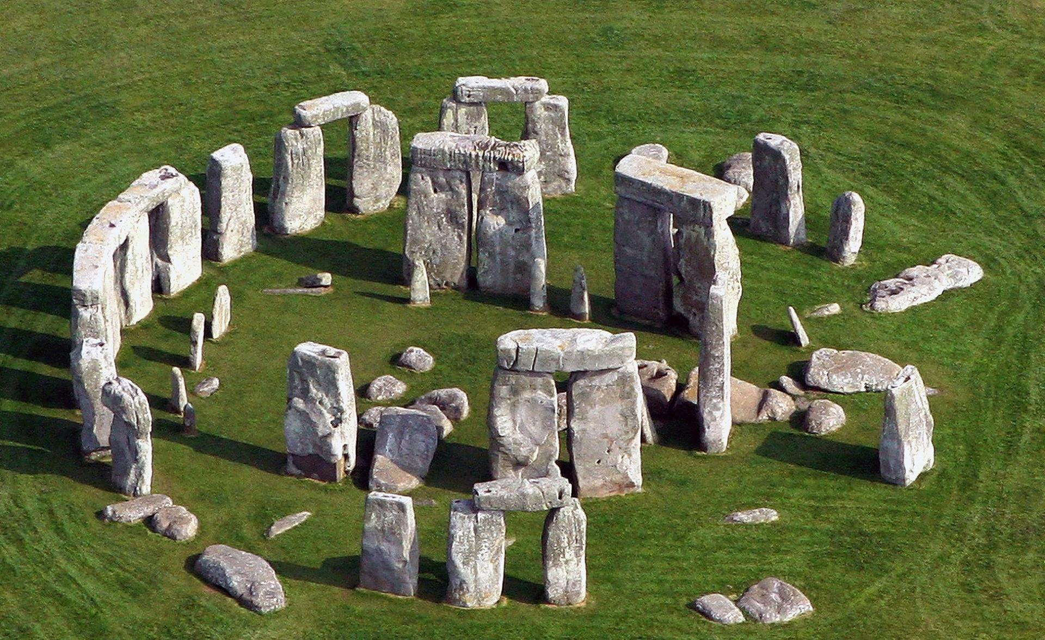
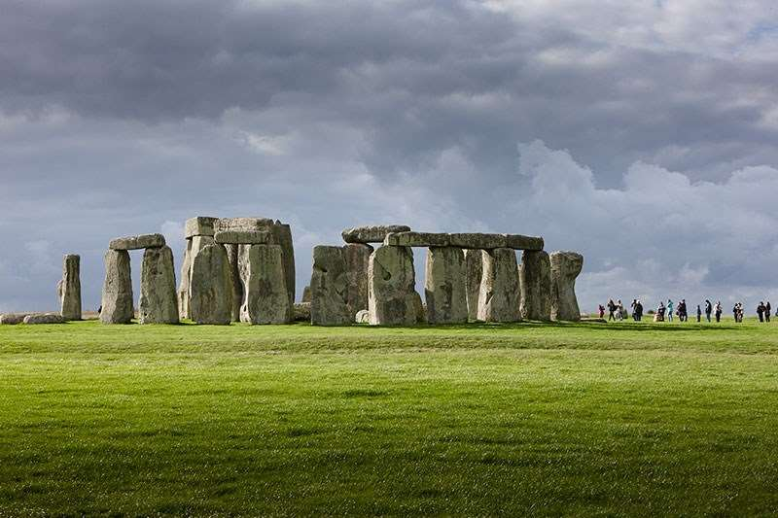
Why is it important to know who the first inhabitants were? If you knew anything about pre-historic Britain & Ireland before you entered this class, one of the answers—and probably the most important to those of us who aren’t history majors—is the monuments they built.
Stonehenge is easily the best known of the pre-historic monuments in the islands. It wasn’t built overnight, but construction began around 3100 B.C. One thing everyone agrees on is that no one knows its purpose. But it was evidently quite important, because, according to geological studies, some of the stones came from Wales. That’s a long way to carry big rocks.

Slide 5
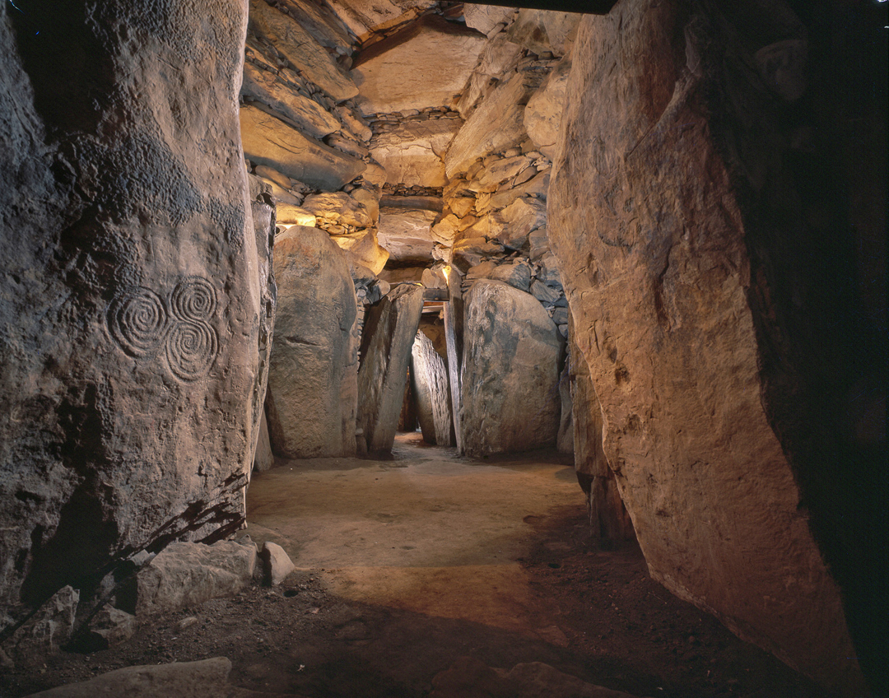
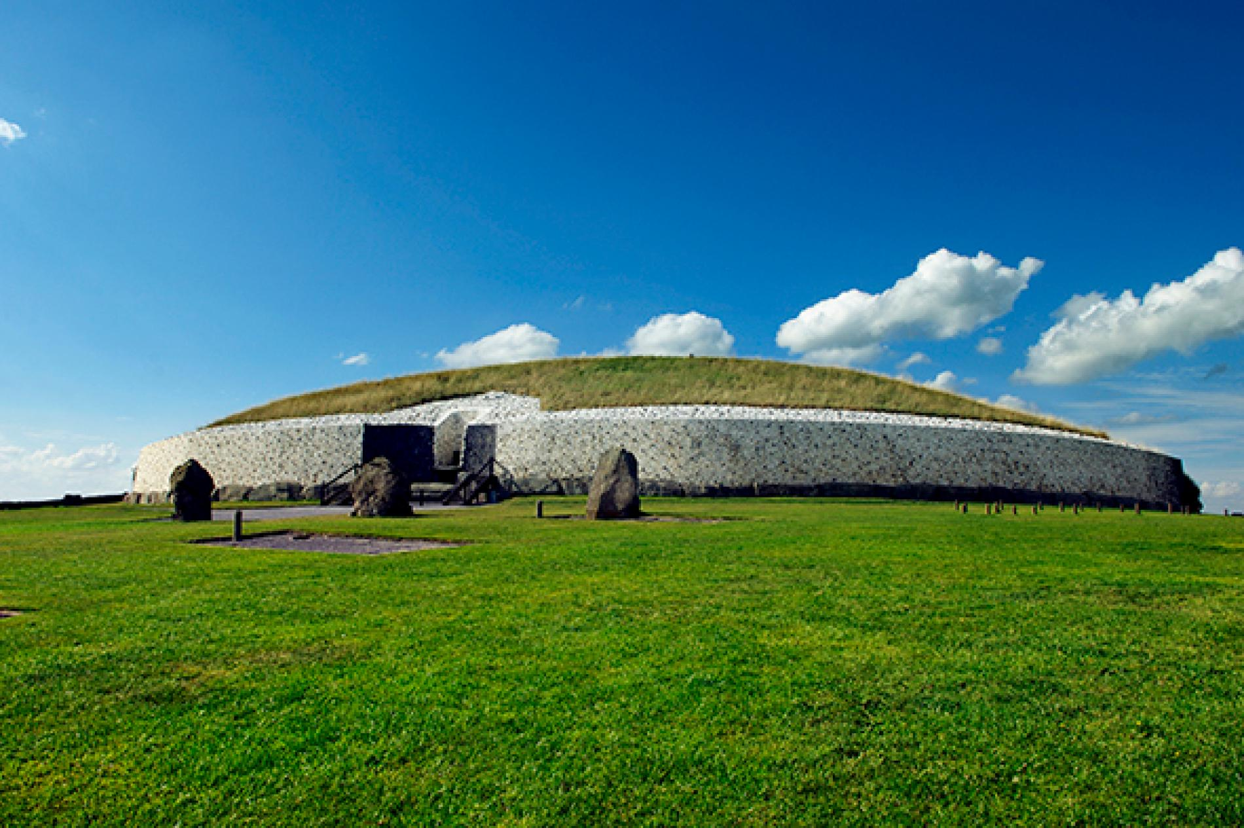
Another significant monument is a passage tomb in Ireland known as Newgrange. It was constructed in 3200 B.C. It’s a large circular mound with a stone passageway & chambers, & it’s 93 yards in diameter (meaning that it covers about an acre) and 15 yards in height. Like that of Stonehenge, its exact purpose is unknown, but the fact that its entrance is aligned with the winter solstice tells us of the engineering skills of its builders: above the entrance to the passage of the mound there is an opening called a roof-box, and “on mornings around the winter solstice a beam of light penetrates the roof-box and travels up the 19 metre (63 ft) passage and into the chamber. As the sun rises higher, the beam widens so that the whole chamber is dramatically illuminated” (http://www.boynevalleytours.com/winter-solstice.htm). Those who have studied it extensively have suggested everything from an astronomical purpose to a religious one.

Slide 6
While Newgrange may be unique because of its alignment to the winter solstice, there are other passage tombs, and although not all are in Ireland, all are thousands of years old. Stonehenge isn’t unique, either; there are stone circles on continents, although not nearly as many as in the British Isles & Ireland. But even with 187 in Ireland alone (most of them not anywhere close to as big as Stonehenge), we still don’t really know who built them or why. People like to say that the Celtic druids built them for religious purposes, and modern-day druids, who, remember, are not a continuation but a new invention, as it were, based on popular (mis)conceptions of ancient druids, probably chose Stonehenge as a ceremonial spot because of the popular notion that the ancient druids built it. But remember that Celts don’t appear in any references before 600 B.C., & even if they’d been around 1000 years before that, they still wouldn’t have been around when Stonehenge was built.

Slide 7
Mallory, in his 328-page book, looks at both fact & legend in his search for the origins of the Irish, so we will too.
Let’s start with some facts. The oldest evidence of human habitation has been dated to approximately 8000 B.C. Mallory devotes an entire chapter to the question of “where did they come from?” but his answer is a disappointing “Wales, Scotland, & the Isle of Man.” This is definitely a “duh” answer, since those were the closest lands. But where did THOSE people come from?
Unfortunately, there’s no answer to that question, at least not in Mallory’s book, which is probably the most recent & thorough work on the origins of the Irish. But, in the first place, we’re very fortunate that there’s any evidence at all left from that long ago, & in the second, as far as we’ve been able to determine, the Sumerians were the first civilization (around 3200 B.C.), and the lack of civilization would make it much harder to classify the inhabitants of any land.
Incidentally, https://www.vocabulary.com/dictionary/civilization defines civilization as “an advanced stage of human society, where people live with a reasonable degree of organization and comfort and can think about things like art and education.”

Slide 8
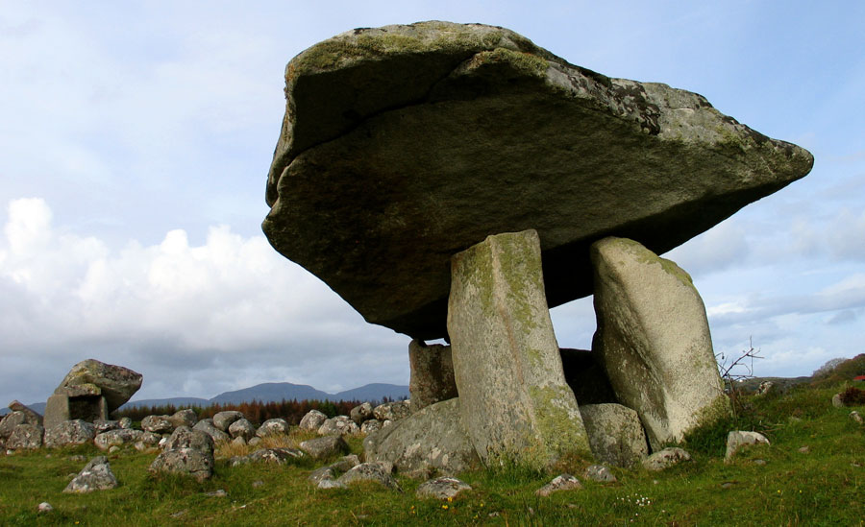
You may know that the earliest people were hunter/gatherers. There is evidence in Ireland that around 3800 B.C., before there’s evidence of civilization as described previously, life in Ireland changed dramatically as farming replaced hunting/gathering as the major form of subsistence. This was not, of course, unique to Ireland; it was a change that spread rapidly over all of Eurasia. The big question here is this: did people from the continent migrate to Ireland, bring farming with them, and take over? Or did farming spread from neighbor to neighbor, region to region, with little migration? Archeologists who used to have a definite opinion aren’t so sure of themselves any more. And for that reason, you won’t find any definite answer here. We are, after all, talking about something that happened 6000 years ago, and our techniques for analyzing discoveries are being constantly improved.
The period we’re discussing when we talk about farming in Ireland is the late Neolithic period, which lasted until around 2500 B.C. in Ireland. You should recognize the significance of the years 3800 B.C. – 2500 B.C. What falls within those years?
Remember Newgrange? (And Stonehenge, although, of course, that’s not in Ireland.) Passage tombs and stone circles began appearing in the late Neolithic period. That could easily indicate that a change in religious beliefs accompanied the change from hunter/gatherer to farming.
Another type of monument to appear during the Neolithic period was the dolmen. A dolmen consists of two or more stones standing upright with a single stone laid across the top of them. There are various theories about the purpose of these monuments, one of which is that they were grave markers, since human remains have been found within some. Not all, however, so they probably served some other function besides or in addition to marking graves.
Kilclooney dolmen in County Donegal

Slide 9
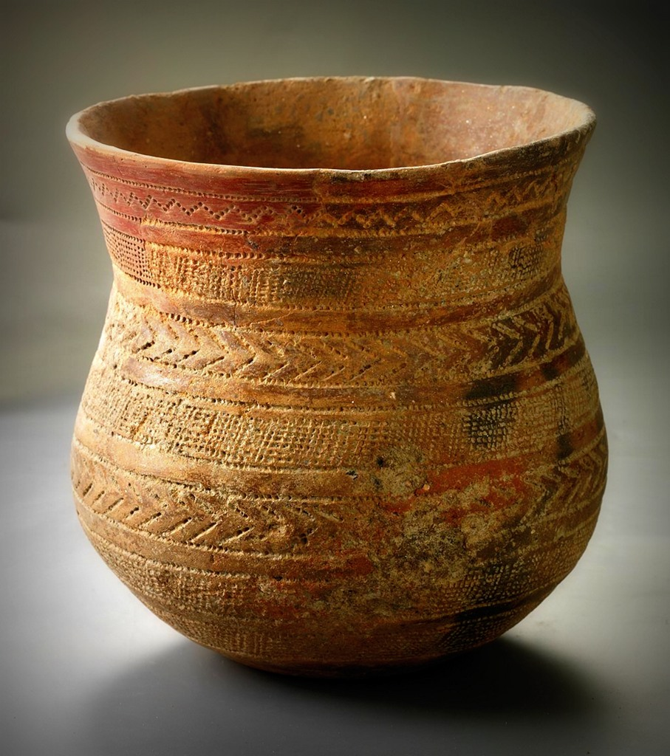
The Bronze Age followed the Neolithic, & a new wave of people (and/or their culture) flowed into Ireland. Ever heard of the Beaker people? Archeologists have discovered a large number of what they call “bell beakers” (so named because of their shape, similar to that of an inverted bell) all over Europe, & they have been dated to the late Neolithic/early Bronze age, or 2900 - 1800 B.C. The appearance of those beakers & associated artefacts allow us to trace the path of the culture that produced them.
There’s no question that the Beaker culture began on the European continent. But what about their arrival in Ireland?
Again, that’s a question archeologists have become hesitant to answer. One
theory is that the Beaker people invaded Ireland (between 2500 & 2100 B.C.). But
another is that Beaker people came to trade. That’s not as simple as having a Beaker salesman show up on your doorstep & ask if he can have a leprechaun in exchange for some of his beakers. There would have been waves of various sizes
as the Beaker people traveled from the continent. The number of Beaker people could not have been insignificant, because they introduced to Ireland not only bell beakers but also new archery equipment &, more importantly, metallurgy.
A relatively new argument in favor of the invasion theory is DNA evidence that the Beaker people replaced the Neolithic people who inhabited Britain. What exactly happened to those Neolithic people is not known, whether they were wiped out by an illness or some other catastrophe to which the Beaker people were more resistant, but there’s no evidence of genocide, so the invasion wasn’t violent. If the DNA evidence is correct, it’s not a stretch to theorize that large numbers of Beaker people also invaded Ireland, although there is no evidence (yet) to suggest that they virtually replaced the previous inhabitants.

Slide 10
At this point, we need to look at what was going on with the Celts. The Bronze Age, which saw the arrival of the Beaker culture in Ireland, was the time of the Hallstatt culture on the continent. The Bronze Age actually began earlier on the continent than it did in Ireland, as did most of these ages, since Ireland is an island and is farther from the continent than is Britain. But if we assume (and that’s an extremely complicated assumption) that the Celts today live in Ireland, we need to look at what’s going on with the continental Celts during the periods we examine in Ireland.
So, by the time the Bronze Age began in Ireland, the continent was in the early Iron Age, which is the beginning of the Hallstatt culture that we saw in the first slide presentation. The big Celtic migrations, remember, had not begun at that time.

Slide 11
The Iron Age in Ireland began around 500 B.C. Obviously, weapons and other objects, tools, etc., began to be made of iron. But more significantly, for our purposes, the La Tène culture began on the continent around the middle of the 5th century B.C. It spread rapidly among--& beyond—Celtic societies.
The traditional theory is that the Celts invaded Ireland during the Iron Age (which lasted until about 400 A.D.). But the new study of DNA (think of all those commercials you see on TV about finding your roots) suggests that that was not the case. It seems that today’s Irishmen cannot trace their DNA back to the Celts we’ve been studying.
Uh oh. What happened?

